Slide 1
Data Visualization
World War ll
Faramarz Zareian

Slide 2
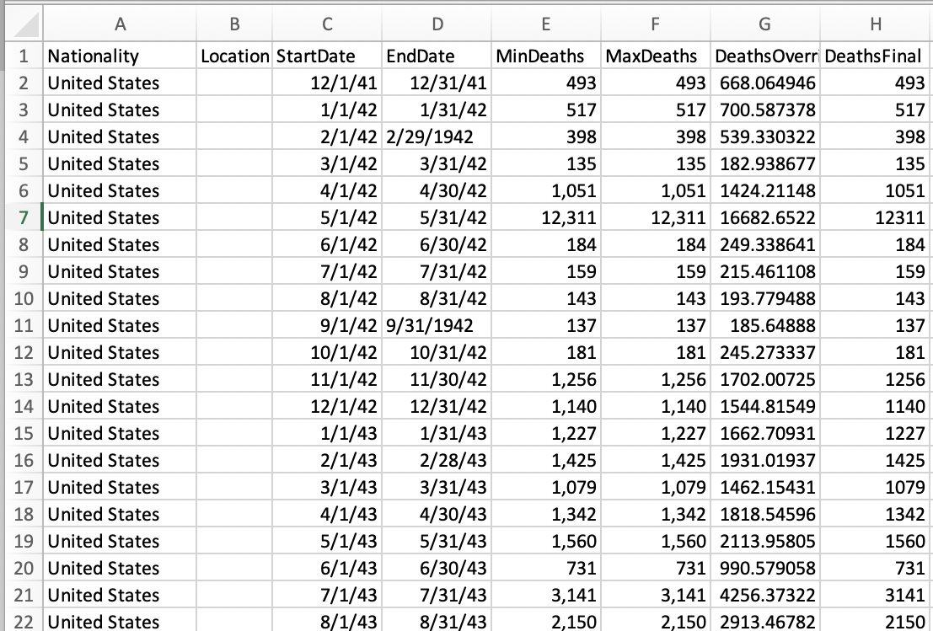
Dataset
World War II Casualties.
Source: Cdmhost & Wikipedia.
Features: 15 columns.
Observations: 638 rows.
Main columns for visualizations:
DeathsFinal, Nationality, Date
World War Casualties

Slide 3
Visualization Parts

Slide 4
WW2 countries casualties
This tab contains 4 sections:
Country names (includes list of all countries in our dataset
Bubble chart (includes name of all countries with sum of casualties representing with the same colors as country names)
Bar chart (shows casualties of country hovered in country names columns sorted by year)
Donut 3D (shows deaths ratio of each country with respect to total casualties of world war)

Slide 5
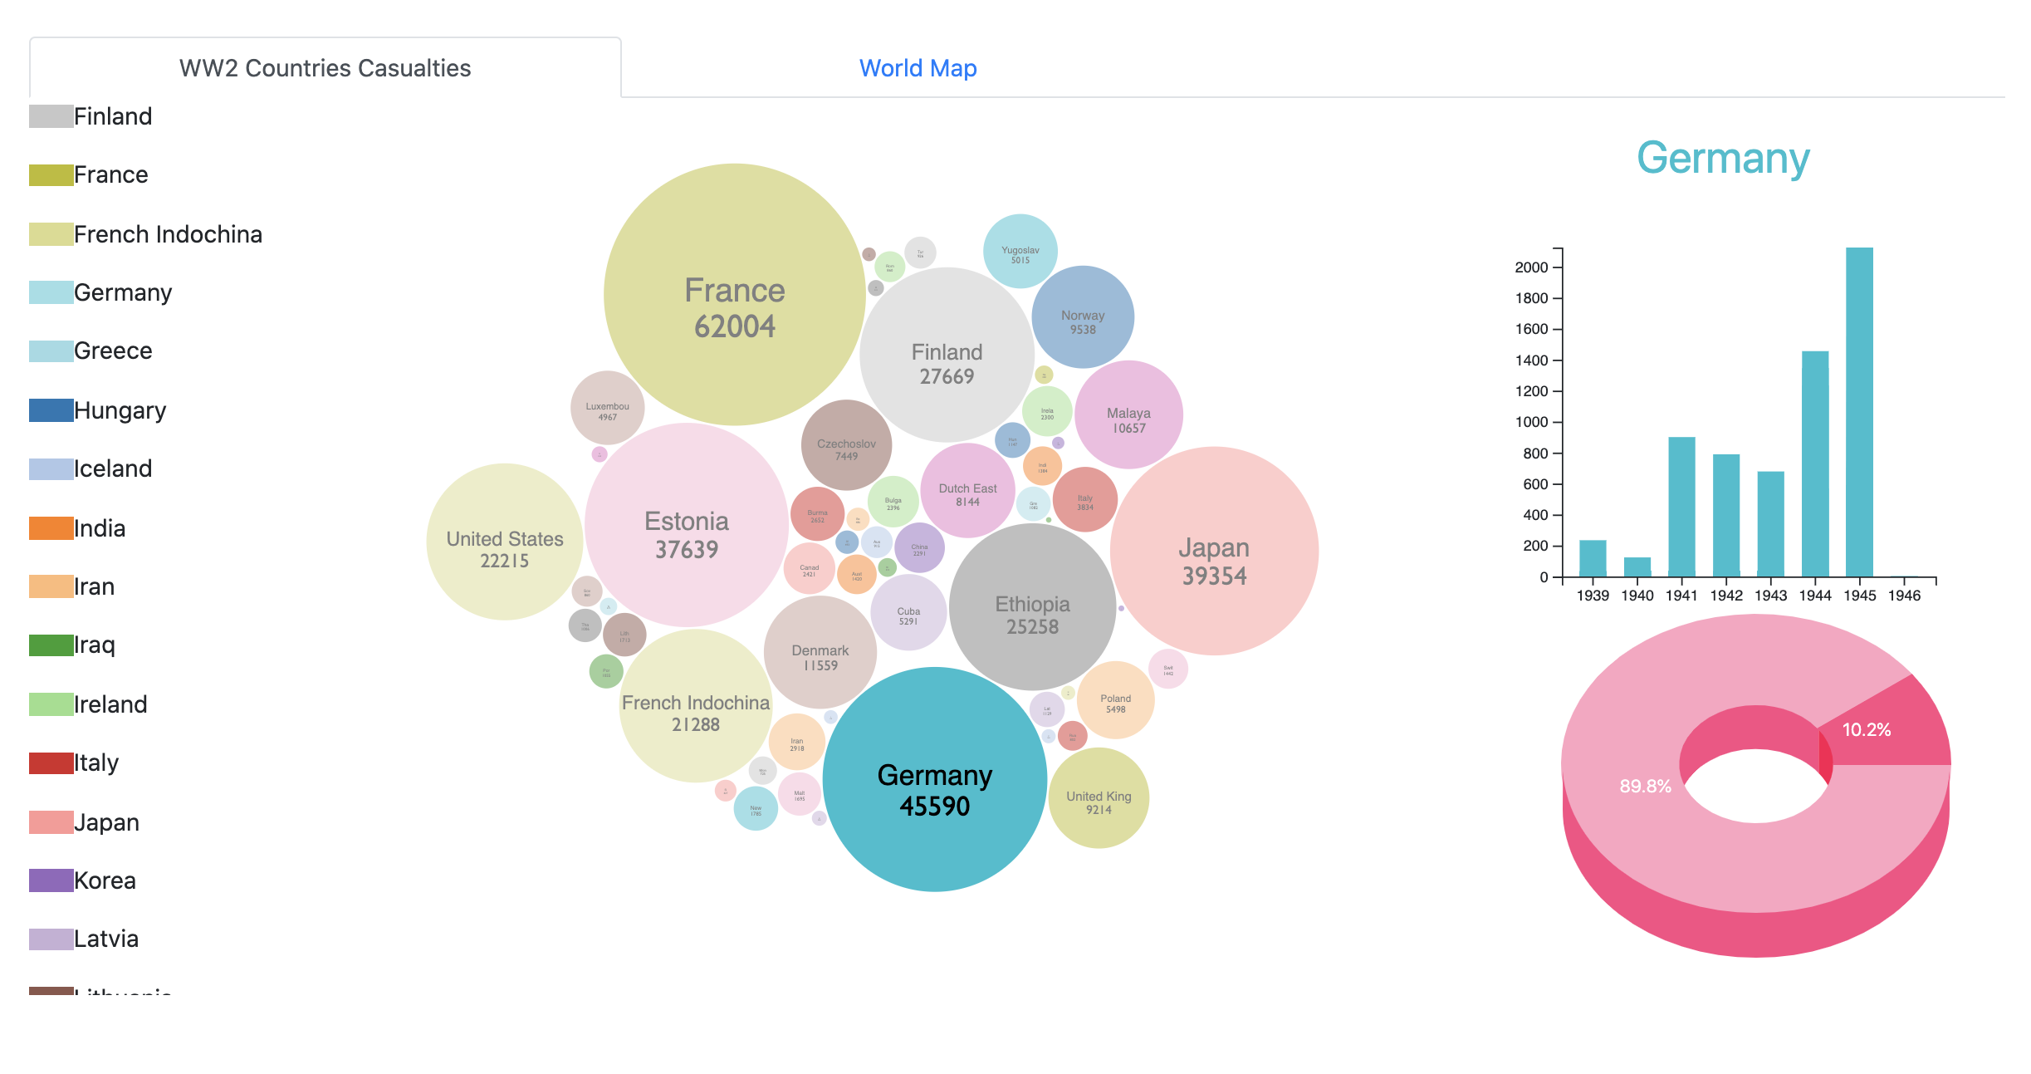

Slide 6
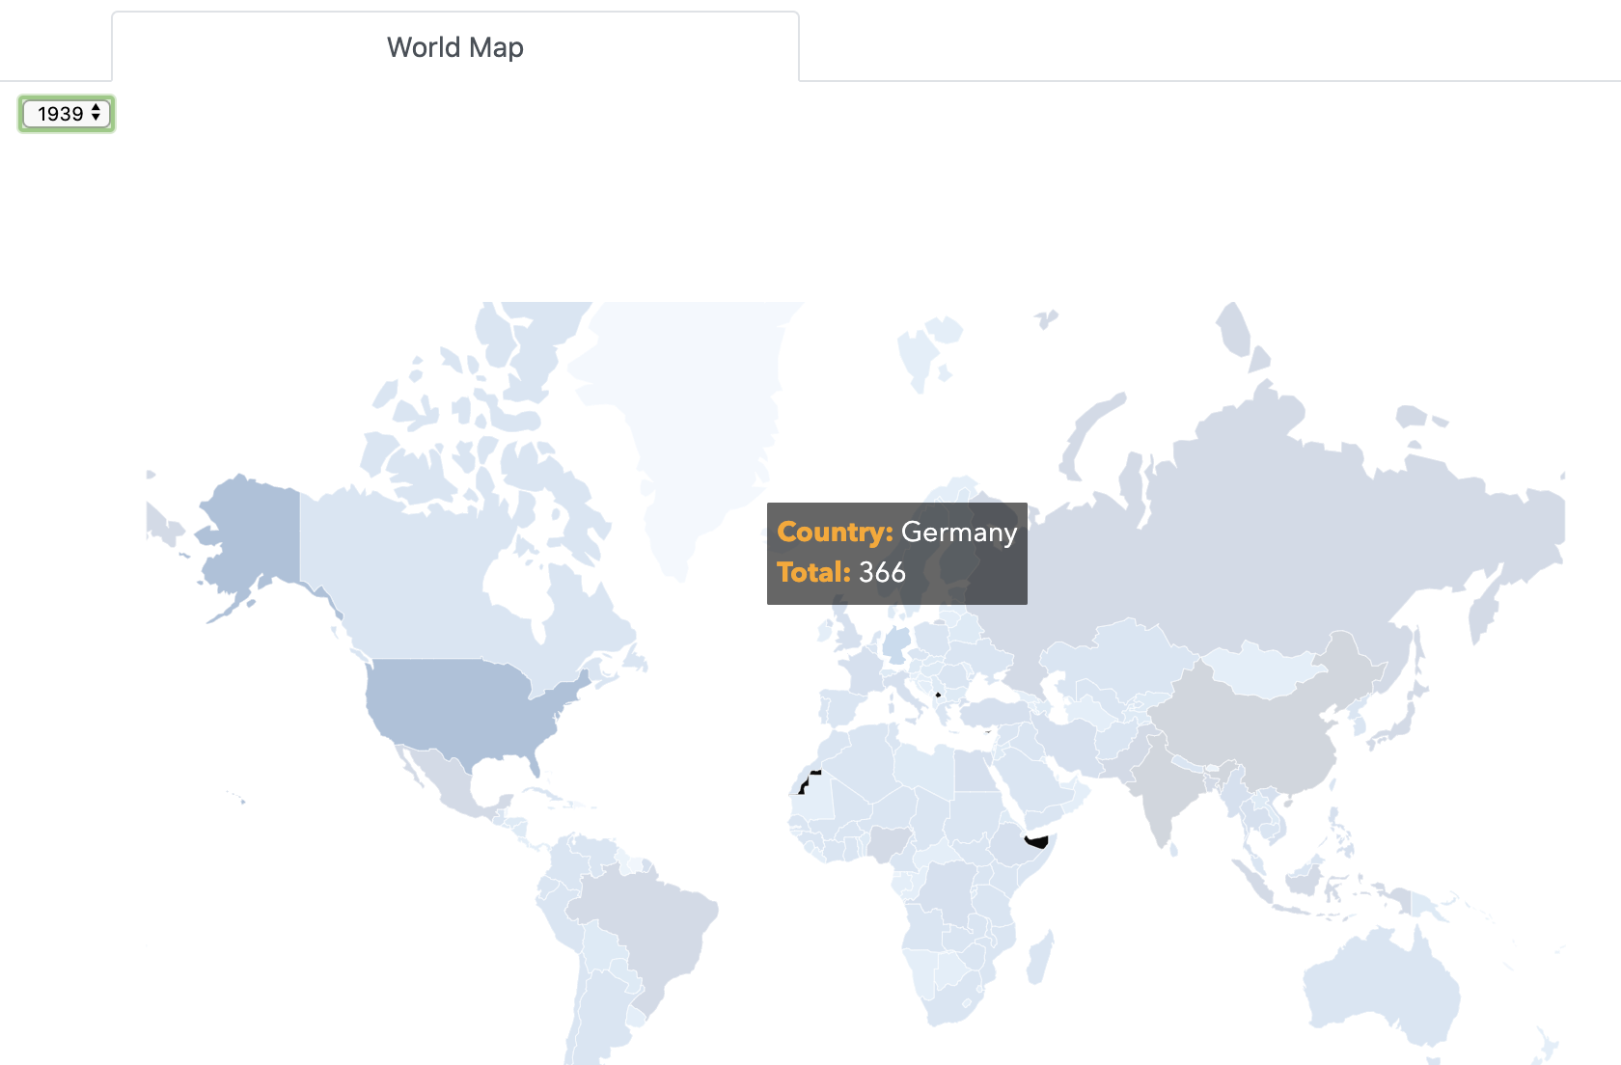
World Map
This tab contains world map of all countries with year selection drop box
By selecting the war year, the related country with number of casualties will shown

Slide 7
Charts

Slide 8
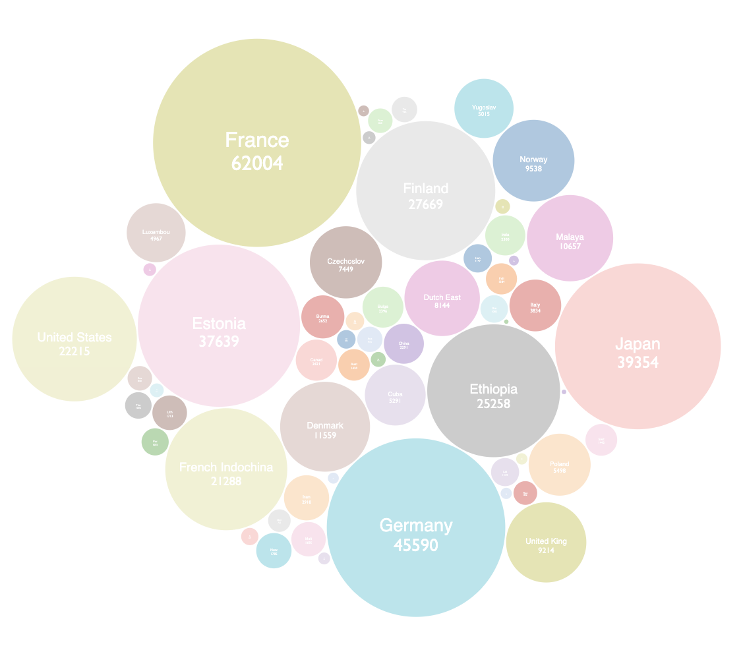
Visualization
Casualties Analysis by Country
Bubble chart
Total number of deaths for each country

Slide 9
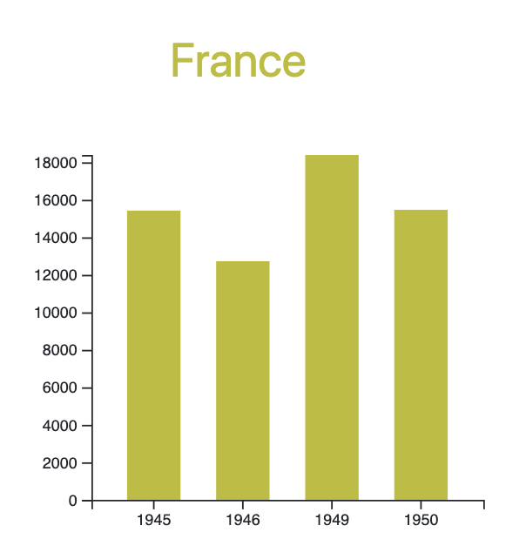
Visualization
Casualties Analysis by Country
Bar Chart
Number of deaths for each year

Slide 10
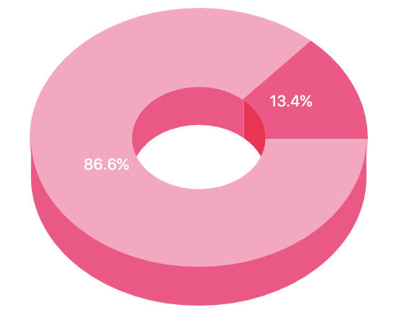
Visualization
Casualties Analysis by Country
Donut 3D
Deaths ratio of each country with respect to total casualties of world war

Slide 11

Thank you

